Slide 1
Global Marketing
Management
A European Perspective
GLOBAL MARKETING
MANAGEMENT AUDIT AND
CONTROL
Warren J. Keegan
Bodo B. Schlegelmilch

Slide 2
Nature of Control
Control
  is defined as the process by which managers ensure that resources are used effectively and efficiently in the accomplishment of organisational objectives
  data measures and evaluations generated by the control process in the form of a global audit are a major input to the planning process

Slide 3
Types of Controls I
Two types of control may be used in regulating subsidiaries
  bureaucratic control (Western organisations)
  cultural control (Japanese organisations)
Distinction between
  formal control
    performance standards, evaluation of actual performance, corrective action to remedy shortfalls
  informal control
    self-control, group control, cultural control through value system

Slide 4
Types of Controls II
The marketing control process makes a clear distinction between
  strategic control
    refers to an organisation’s implicit and explicit goals, objectives, strategies, and capacity to perform
    ensures that they are performed well - “doing the right things”
    aims at defining the fit between capabilities and objectives of an organisation and its environmental threats and opportunities
  operations control
    is concerned with the task of how well the organisation performs - “doing the things right”

Slide 5
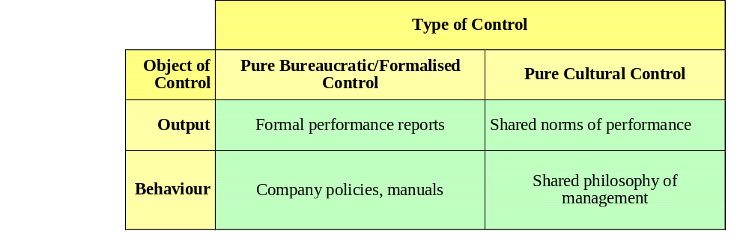
Types of Controls III
Comparison between bureaucratic and cultural control mechanisms:
Source: Czinkota, Michael R. and Ilkka A. Ronkainen. Global Marketing. Fort Worth: The Dryden Press, p. 285.

Slide 6
Variables affecting Control
Communication System
  distance between head office and overseas divisions
  location
Data
  economic, industrial, and consumer information
Diversity of Environment
  currency values, legal structures, political systems, advertising options, and cultural factors

Slide 7
Control System
A good control system consists of
  the establishments of standards
  the measurement of performance
  the analysis of deviations
The use of these elements creates tensions and problems
Corporate strategy can be harmed by ineffective or defective control systems

Slide 8
The Global Marketing Audit
A global marketing audit can be defined as:
A comprehensive, systematic, and periodic examination of a company’s or business unit’s marketing environment, objectives, strategies and activities, which is conducted with the objective of identifying existing and potential problems and opportunities and recommending a plan of action to improve a company’s marketing performance.

Slide 9
Types of Marketing Audit
Two types of audit
  independent marketing audit
    conducted by someone free from influence of the organisation being audited
    lack of understanding of the industry by the auditor
  internal or self-audit
    conducted by marketers who understand the industry
    it may lack the objectivity of an independent audit
⇨ conducting both periodically for the same scope and time period and comparing results

Slide 10
The Process of Marketing Audit
Meeting between company executives and the auditor to agree on
  objectives, coverage, depth, data sources, report format, time period for the audit
Gathering data
  detailed plan of interviews, secondary research, review of internal documents
Preparing and presenting the report
  report restates the objectives and scope of the audit, presents the main findings and major recommendations

Slide 11
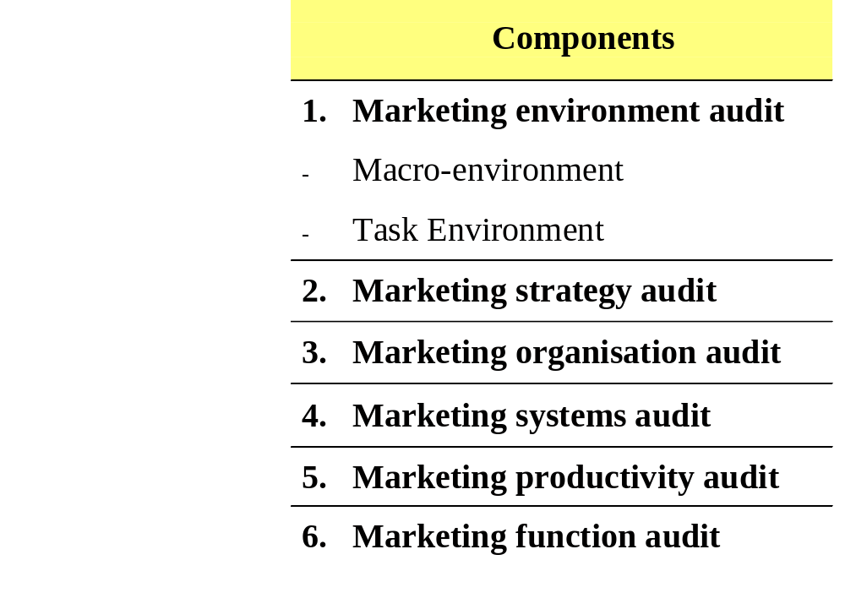
Components of the Marketing Audit
Source: Kotler, Philip. Marketing Management. Analysis, Planning, Implementation, and Control. London: Prentice-Hall, 1991.

Slide 12
Problems of the Marketing Audit I
Setting Objectives
New Data Sources
Report Presentation
  executive who commissions the audit may have higher expectations about what the audit will do for the company than the actual results seem to offer
  important to recognise that improvement at the margin is the winner’s game in global marketing

Slide 13
Problems of the Marketing Audit II
Control of subsidiary operations
  shift of balance of power in the organisation
  strong resistance to change
  three types of mechanisms are available to help headquarters maintain control
    data management mechanism
    managers’ management mechanisms that shift the perception of self-interest
    conflict resolution mechanisms

Slide 14
Relationship between Strategic Control and Planning
Does strategy require change?
Formulate Organisational Strategy
Yes
No
Do plans require change?
Formulate Organisational Plans
Yes
Set Standards of Operating Performance
Marketing
Production
R&D
Finance
Personnel
No
Review Standards
Do results match standards?
Measure Actual Operating Results
No
Yes

